Slide 1
OPERATING SYSTEMS AND SYSTEM PROGRAMMING
FileMind
Intelligent File Access Prediction System
Project Team Members:
Shravya
Ashritha
2510030123
2510030120
Ansh
Akshitha
2510030002
2510030176

Slide 2

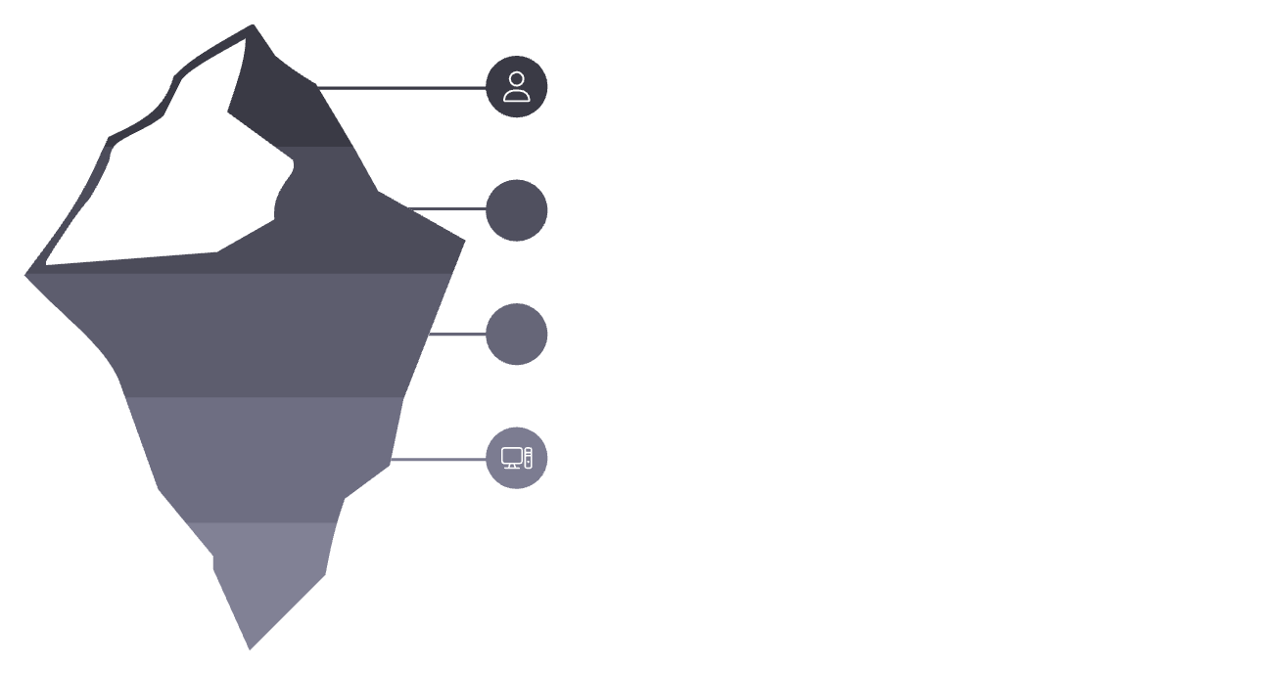
OVERVIEW
Abstract
FileMind is an intelligent file access prediction system that monitors user file-access behaviour, analyses historical access patterns, and predicts the file most likely to be accessed next. The predicted file is then intelligently prefetched into memory, reducing access latency and improving overall system responsiveness.
User
Pattern Analysis
Operating System
Prefetching
Application Layer
Data Storage
File Access
Prediction
Each stage operates seamlessly within the operating system layer, ensuring minimal overhead while delivering measurable improvements in file access performance.

Slide 3
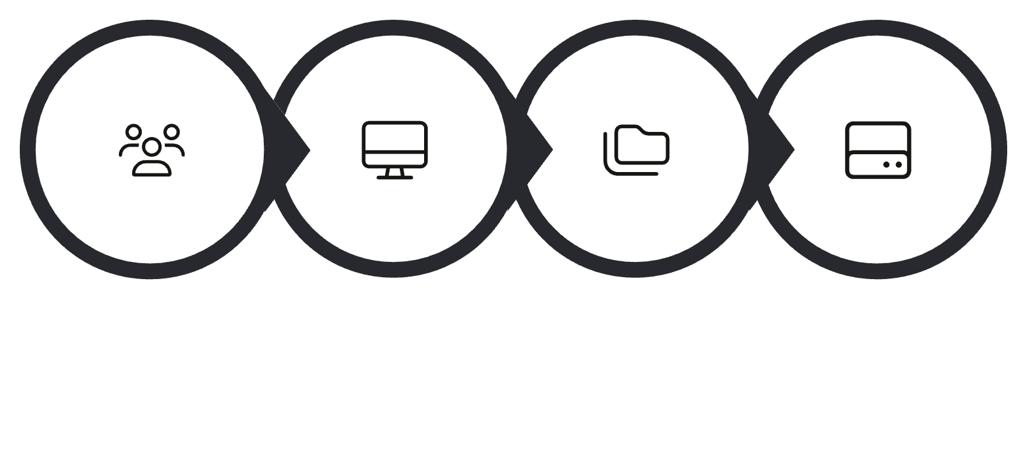
EXISTING SYSTEM
Existing System
Traditional operating systems respond to file requests only after the user initiates them. There is no mechanism to anticipate future access behaviour — the system reacts rather than predicts.
User Request
Operating System
File System
Disk I/O
The conventional file access pipeline follows a strictly reactive path — every stage is triggered only after the previous one completes, introducing inherent latency at each transition.
Manual Access
Traditional Caching
Disk-Based Retrieval
Static Behaviour
Users explicitly request each file; no proactive loading occurs.
Recently used files are cached, but without behavioural intelligence.
Every miss results in a full disk I/O operation, incurring latency.
The system does not adapt or learn from user access patterns over time.

Slide 4
PROBLEM STATEMENT
Drawbacks of Existing System
1
Higher Access Time
Every file request incurs full disk retrieval latency with no pre-loading.
2
Unnecessary Disk I/O
Repeated sequential reads generate avoidable disk operations, degrading performance.
3
No User Behaviour Learning
The system does not track or learn from individual user access habits.
4
No Future Prediction
There is no mechanism to anticipate which file will be needed next.
5
Limited Optimisation
Caching strategies are generic and not tailored to individual usage patterns.
Traditional Approach
FileMind Approach
Request → Search → Access
Observe → Predict → Prepare → Access

Slide 5
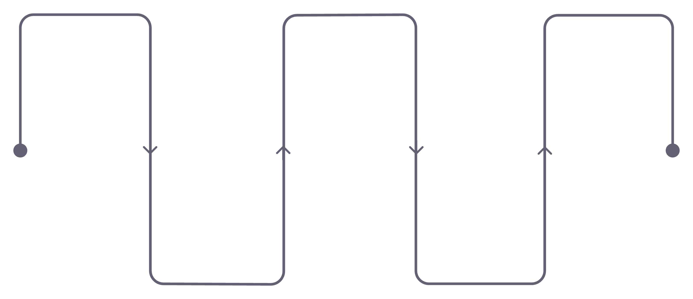
PROPOSED SOLUTION
Proposed System
FileMind continuously monitors file-access activity, builds a historical access log, and applies machine learning to predict the next file a user is likely to access. The predicted file is prefetched into memory before the request is made, significantly reducing access latency.
Access Monitor
Pattern Analysis
Intelligent Prefetching
Continuously track file access
Discover usage patterns
Prefetch predicted file
Access History
ML Prediction Model
Build a temporal access log
Predict next file access
This end-to-end pipeline transforms reactive file access into a proactive, intelligent process — each stage feeding seamlessly into the next to enable real-time prediction and prefetching.

Slide 6
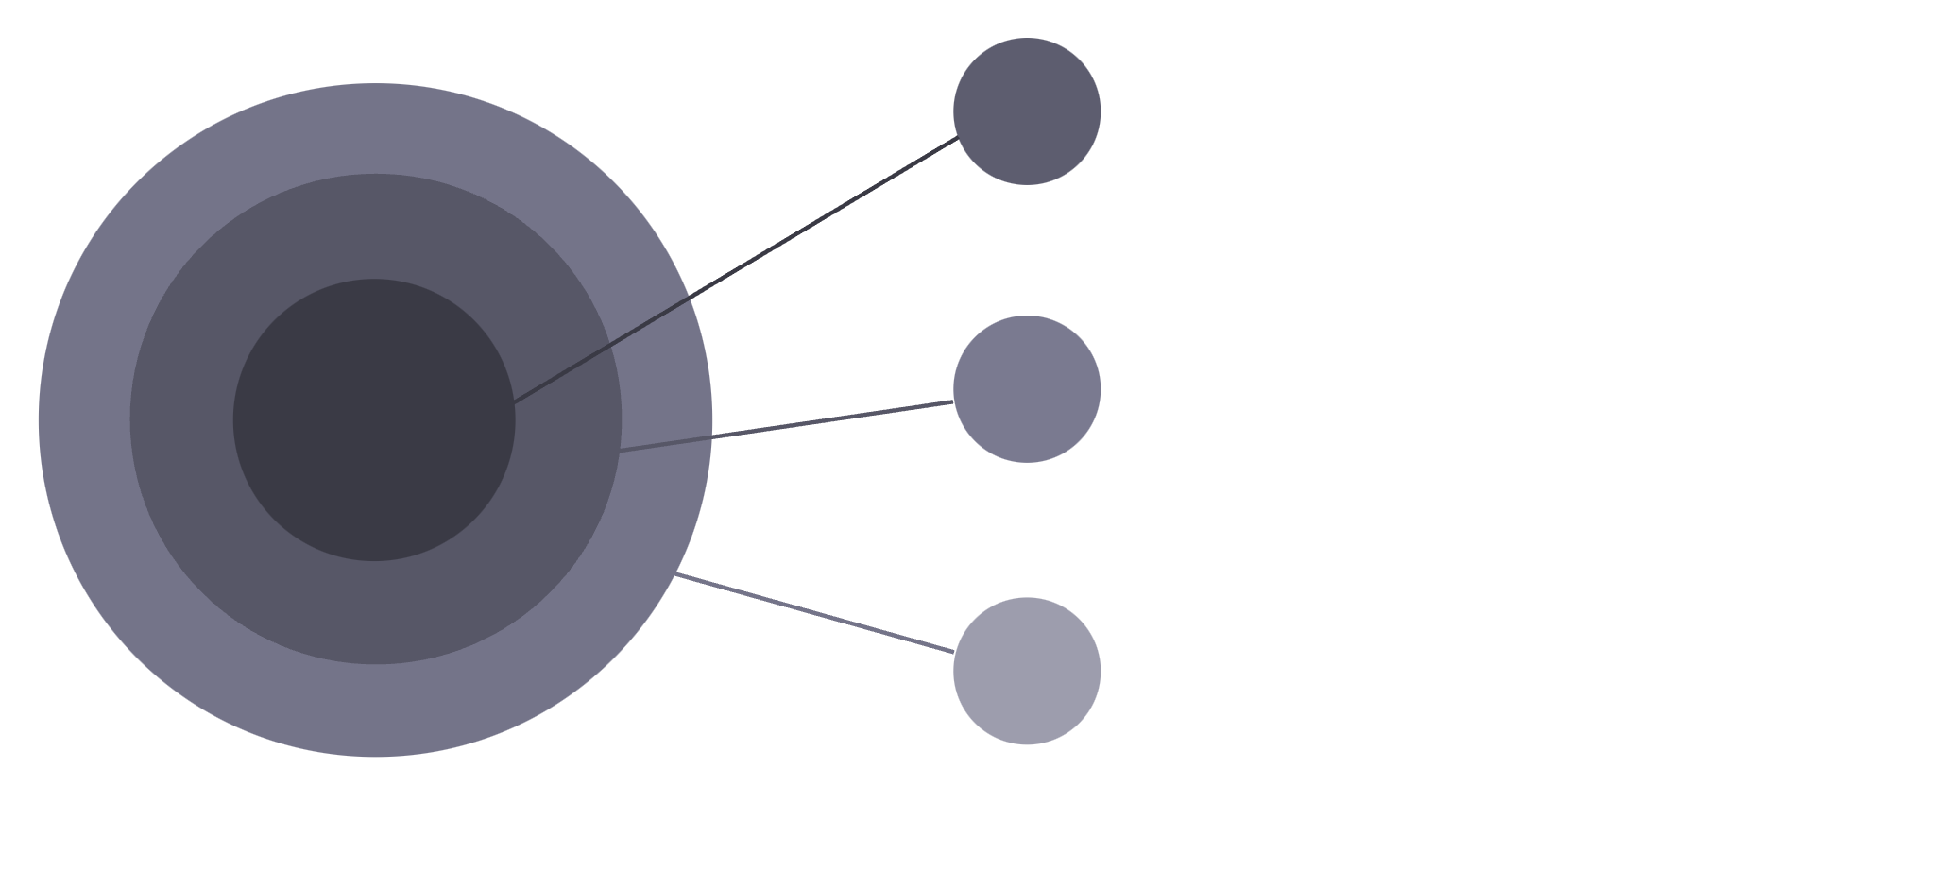
ARCHITECTURE
System Workflow
FileMind integrates three core domains — Operating Systems, System Programming, and Machine Learning — into a unified intelligent file management pipeline.
Machine Learning
Access history, pattern detection, prediction
System Programming
Linux syscalls, file handling, monitoring
Operating System
File system, access events, disk I/O
The Operating System layer captures raw file events, System Programming translates these into structured data via Linux system calls, and the Machine Learning layer derives predictive intelligence from the accumulated access history.
Input
Processing
Prediction
Action

Slide 7
REQUIREMENTS
Hardware & Software Requirements
Hardware
Software
Laptop / Desktop
4 GB+ RAM
Modern Processor
10 GB+ Storage
Linux / Ubuntu
C / C++
Python
GCC
Linux System Calls
NumPy · Pandas · Scikit-learn
VS Code
The hardware requirements are modest, ensuring FileMind can be deployed on standard development machines. The software stack leverages widely available open-source tools, with Linux system calls forming the bridge between the OS kernel and the prediction engine.

Slide 8
OUTCOMES
Expected Outcome
Traditional File Access
FileMind
User Request → Disk Access → File Retrieval
User Behaviour → Prediction → Prefetch → Faster Retrieval
Faster File Access
Reduced Disk I/O
Prefetching eliminates wait time for predicted files.
Fewer physical reads through intelligent pre-loading.
Improved Responsiveness
Adaptive File Management
System anticipates needs before the user acts.
ML model continuously learns and refines predictions.
FileMind — Predict. Prefetch. Perform.

Slide 9
Actual flow:
USER
↓
FILE ACCESS
↓
OS FILE SYSTEM
↓
LINUX SYSTEM CALLS
↓
ACCESS HISTORY
↓
PATTERN ANALYSIS
↓
ML PREDICTION
↓
PREDICTED FILE
↓
PREFETCH INTO MEMORY
↓
FASTER ACCESS

Slide 10
Thank you!

